Slide 1
Early Literacy at Home
4. IMPACT

Slide 2
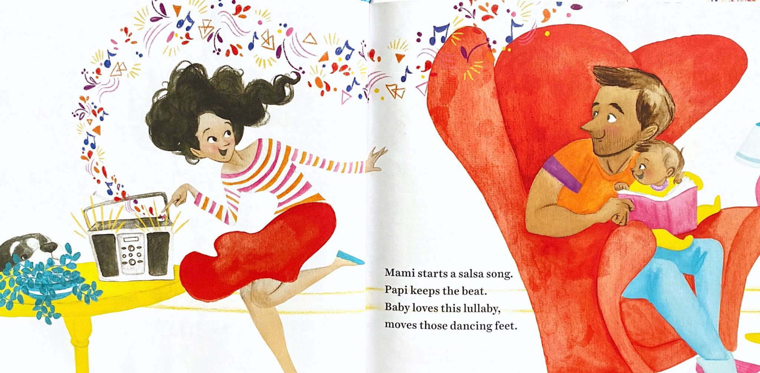
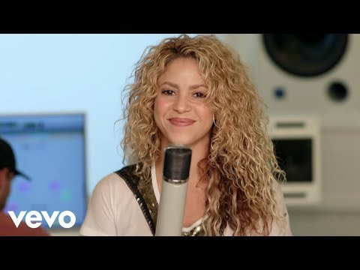
Early Literacy at Home
Day 4: IMPACT
Please rename your zoom image to:
Organization Initials, Your Name
BSI = Be Strong International
FIU = Florida International University
UM = University of Miami
MCT = Miami Children’s Trust
M-DCPS = Miami-Dade County Public Schools
See you at 3:05 pm.
Music:
Shakira, Try Everything
Notes:
3-3:05
5-minutes
MUSIC: https://youtu.be/9aRZLbZFeLU

Slide 3
Opening Circle
Tell us your name and tell us about a Community you are a part of.
“I’m __________, and ________________ is my community.
Then, tag the next person.
Notes:
3:05-3:25
20-minutes
Welcome back to our Community Living Room.
Today we are talking about VOICE!
The voice is so important to the young developing brain- talking to babies let’s them know you care about their thoughts- babies can already recognize their mother’s voice when they are born. Voice, smell and touch. Developing voice is a human’s work.
Opening circle is going to tell us your name and something you love of our life. Do more than tell us- show us by emphasizing the word LOVE.
Then tell us the name of your favorite creature.
then tag someone.
The person you tag will start their Opening with the sound they think your favorite creature might make.
And your are goin to do this activity with all the confidence you can fake. Just plow right through it- be speedy and and don’t correct yourself-if you can;t think of the creature sound - make it up.
La Fuerza Team will start.
MEOW! I’m Michelle- something I love about my life is that I’m and aunt to my twin nephews. My favorite creature is a Duck..
Q:What’s the value of starting each session with an appreciation?
Gratitude practices do more than just uplift.
As you are aware caregivers are navigating an interaction of issues and multiple barriers to feeling their powerful influence as their child’s most important person.
Get our minds in the game- we all have something to contribute.
This introduction is a story! A story we are telling about ourselves and the work of caring we all do.
Raise your hand if you worked hard today! Your work is hardwood- good work- important work.
You made time join this community of practice- your individual strengths.

Slide 4
Community Learning Activity
Listening Exchange
Pair share....
One person is telling and the other listening.
Each person speaks for 2 minutes uninterrupted.
The Person speaking keeps the time.
Switch- do not comment on what the other person said.
Listen like you care about the speaker.
Notes:
3:30-3:40
10-minutes
WhatsApp Challenge- DIFFICULT CONVERSATION
Q: What do you consider a difficult conversation?
Q: Have you facilitated a difficult conversation? If yes, what was difficult about it and how did you manage it?
Q: You were asked to find a facilitation resource
Emotion high- triggering or sensitive topics
Crying
Argumentative
Stories that take over
Trauma
TIPS
Impact of Trauma on a community
Agreements
Have a few key phone numbers handy- it helps to ask your partner organization- if you at at a school you might already have a person they can connect with.
Modeling a short answer- written prompts help - to stay on track with time.
BUILD ON THE COMMUNITY- allow them to broker resources
Use the group- invite others to empathize by raising their hands, using emojis
Use the group by getting advice from another member who has navigated a similar issue. “What katherine shared was very powerful? Has anyone here ever been in this situation? Can you offer her some encouragement?
Is anyone aware of a resource for Katherine? Here at the school or in the community?
Use the chat to share resources. That sounds stressful to navigate on your own- I will do research and get back to you.
Whenever you want to offer advice- don’t ask a question of the group or the person.
Go to a listen exchange or break out group.
Encourage the group to support eachother.
BUILD ON THE COMMUNITY- allow them to broker resources
sure it?

Slide 5
Preparing for your Workshop
Recruiting Tips & Flyer
Caregivers: Target Spanish-speaking caregivers with children 0-7 years of age who can commit for the 2-weeks.
Workshop Structure: Five 90-minute session over a 2-week period. Ex. Sept 22-29 W, F, M, W, F.
Group Chat: We use WhatsApp- you?
Recruiting: Recruit 15-20 caregivers. In-person or virtual?
Coaching: Have you scheduled? Weekly, Sept 13 - Oct 6
IMPACT: What does a year of programming look like at your organization?
Notes:
3:40-3:50
10-minutes
End by mid-Oct
Who is the facilitator(s)?
What is your Target 2-week time period?
Group Chat? WhatsApp?
In-person or virtual?
Have you signed up for coaching? https://www.tfaforms.com/4927064
What does a year of programming look like at your organization?
Coaching registration link: https://www.tfaforms.com/4927064

Slide 6
Community Learning Activity
Breakout (10-minutes)
Team Huddle
Facilitator(s)
When? 2 Weeks
Group Chat?
In-person or Virtual?
Notes:
3:40-3:50
15-minutes (organizational peer groups)
We are going to break out with your organizational colleagues.
With your peer coaches....
In the chat your team must answer the following:
Who is the facilitator?
What is your Target 2-week time period?
Group Chat? WhatsApp?
In-person or virtual?
Have you signed up for coaching? https://www.tfaforms.com/4927064
What does a year of programming look like at your organization?
sure it?

Slide 7
TOOLKIT LESSONS
LESSONS: Early Literacy at Home
Creating Stories
Animating with Expressions
Playing with Household Objects
Exploring Sounds
Physical Play
Read Alouds
Model reading strategies.
Website landing page
CURRICULUM MAP & STATE STANDARDS
Notes:
4:00 -4:05
5-minutes
In the chat - tell us who was your favorite creature!
We don’t do this activity with parents in our programs - because they are not experienced zoomers or use to a culture of zoom meetings the instructions are complicated.
However we do have a lesson using your voice to animate a story.
DROP FLORIDA LARDING STANDARDS IN THE CHAT
https://dochub.com/michellel-amrzvb/P0B76b3K6NDpWq1Kn2y1Gg/florida-pdf?dt=C32yHfHyxUFyW9hM75iN
Can someone read aloud the parent objectives for Lesson 2?
….Purpose of animating with expressions- in preparing a child for school?
….Whats the Home to school connection?
Parent practice animating and activating bools with the voice

Slide 8
INCREASE
Parents see themselves as their child's best teacher
INCREASE
In parents who can list 3 language-rich activities with their children
INCREASE
Frequency in which parents use online resources to read with their children
INCREASE
In confidence helping children use online educational platforms
INCREASE
Parents who have implemented 2 or more strategies learned in LFFL
Notes:
4:05 -4:10
5-minutes
Data Collection in Genral
Demographic,
Telephone for unique identifiers- share a report with you
School readiness goals- for K in FL
The slide - READ - Highlight from Evaluation

Slide 9
The Power / The Force
Your positive energy influences your child’s confidence to learn something new.
How can we make that happen?
How does a bird learn to fly?
That looks heavy, let’s push it together.
How are you using the power of your influence?
Notes:
5-minutes
Let’s do a group discussion: In our workshops, we emphasize the use of their voice. After watching, a clip from the story, parents usually share their childhood experiences and their experiences as parents as well. One of the techniques we use to spark more conversation among all participants is by presenting a consejo card, like this one. This one says ….. [READ]
Use this consejo to get you thinking with your group about a Moment of Connection you can create.

Slide 10
Community Learning Activity
Breakout (10-minutes)
Brainstorm with your peer coaches....
Use the consejo to get you thinking about the power of your influence.
How many Spanish-speaking caregivers can you impact? What support do you need?
Notes:
4:10-4:25
15-minutes (organizational peer groups)
We are going to break out with your organizational colleagues.
With your peer coaches....
READ SLIDE
We will take 15 minutes for this community learning activity
Someone should take notes
MY CONNECTING POINTS
Sign up for coaching
sure it?

Slide 11
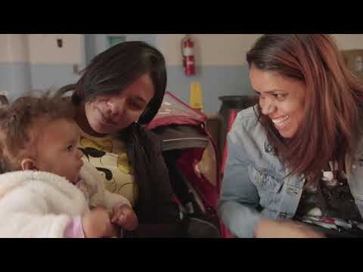
Your impact...
Increase caregiver self-esteem
Highlight Latinx culture & bilingualism
Provide the opportunity for expression, reflection, and companionship
Provide the opportunity to change their story
Motivate participants to reach their greatest potential as caregivers
Notes:
4:25-4:30
5-minutes

Slide 12
Closing Circle
Tell us your name and share your POWER.
“Mi Fuerza es/is _______________ .”
Then, tag the next person.
Notes:
4:45-5:00
15-minutes

Slide 13
POST-survey
Link in the chat box…
Click on the POST-Survey LINK
Turn off your camera.
Fill out the survey!
Turn the camera on when you're finished. (approx, 10 minutes)
*Raise your hand if you need help.
Notes:
4:35-4:45
10-minutes
Katherine drop the link in the chat.: https://www.tfaforms.com/4928587

Slide 14
Next Steps
Data Collection for Family Engagement Workshops
Toolkit will arrive via Drop Box to all Certified Facilitators
Recommend Binge watching the La Fuerza de Creer Telenovela
Reviewing Digital Assets on the website www.lafuerzadefamilias.org
Notes:
4:30-4:35
5-minutes
Seize the Coaching Opportunity to dig in Wed, Sept 13 at 12pm, FR Sept 15 at 10am

Slide 15
Coaching
Sign up!
Survey
Fill out Final Survey
ASSIGNMENT!
Review the Toolkit that will be sent via email.
Visit:
Lafuerzadefamilias.org
See you at our Coaching Sessions starting Monday, September 13th!
ANNOUNCEMENTS
Notes:
4:50-4:55

Slide 16
Contact:
Michelle López
michellel@literacypartners.org
www.lafuerzadefamilias.org
@fuerzafamlatina
@fuerzafamlatina
Notes:
Follow up:
MOC
Read Aloud: Sonadores https://www.lafuerzadefamilias.org/read-aloud/sonadores/

