Slide 1
Early Literacy at Home
2. VOICE: Social Justice Framework

Slide 2
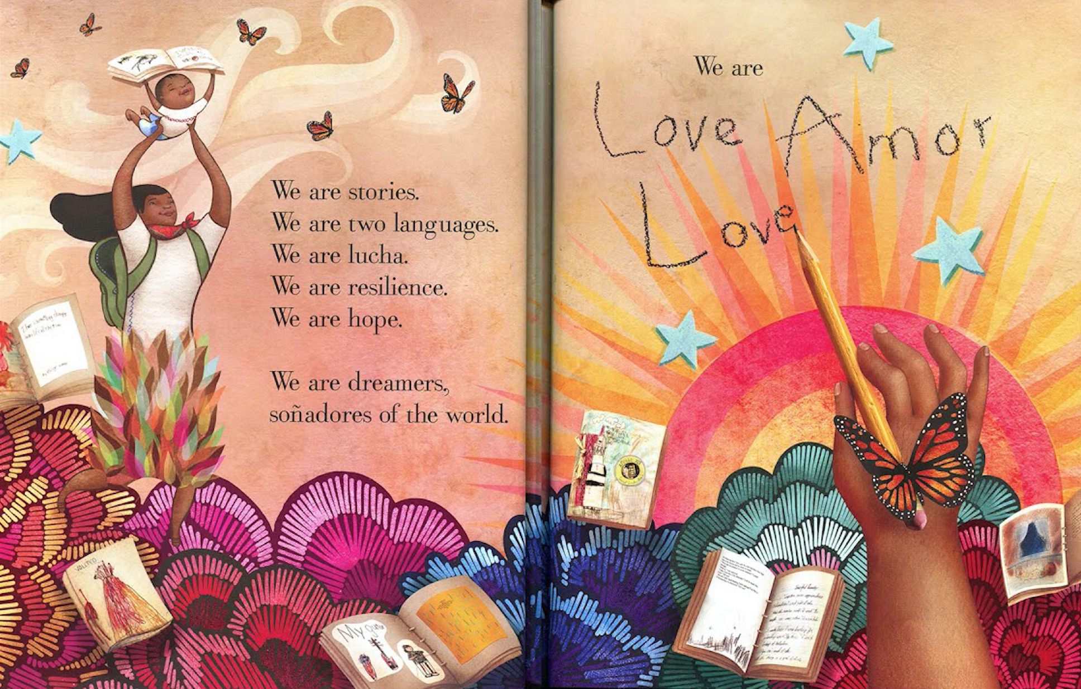
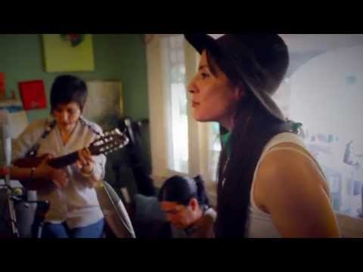
Early Literacy at Home
Day 2: VOICE
Please rename your zoom image to:
Organization Initials, Your Name
BSI = Be Strong International
FIU = Florida International University
UM = University of Miami
MCT = Miami Children’s Trust
M-DCPS = Miami-Dade County Public Schools
Do you have your cafecito? See you at 3:05 pm.
Music:
De Colores by Las Cafeteras
Notes:
3-3:05
5-minutes
MUSIC: https://youtu.be/9aRZLbZFeLU
The image is a spread from the book SOnadores- Dreamers by the author/illustrator Yuyi Morales who is Mexican AMericaan
.
Music you enjoyed is performed by La Cafeteras a Chican band from East LA- The song is a traditional Spanish language song called De Colores
A Mexican folkloric song- originates from the Americas- use by Farm Union in rallies- theme the diversity of many things we love of many colors - celebrate nature
We are on day 2 of 4 of Facilitator TRaining
Yesterday I sent out the deck and recording from 1st session
Also sent WhatsApp messages and _____engagment.
2 hour sessions via zoom and whatsapp
Following this session you will receive your assignment for tomorrow.
DAY 2: VOICE: Social Justice Framework
Facilitation Strategies & Community
Centering Caregiver Voice & Strengths
Navigating Difficult Conversations

Slide 3
Opening Circle
Tell us your name and tell us one thing you love about your life. Then make the sound of your favorite creature.
“ I’m ____________.
Something about my life that I really love is ________. My favorite creature is________.”
Then, tag the next person.
Notes:
3:05-3:25
20-minutes
Welcome back to our Community Living Room.
Today we are talking about VOICE!
The voice is so important to the young developing brain- talking to babies let’s them know you care about their thoughts- babies can already recognize their mother’s voice when they are born. Voice, smell and touch. Developing voice is a human’s work.
Opening circle is going to tell us your name and something you love of our life. Do more than tell us- show us by emphasizing the word LOVE.
Then tell us the name of your favorite creature.
then tag someone.
The person you tag will start their Opening with the sound they think your favorite creature might make.
And your are goin to do this activity with all the confidence you can fake. Just plow right through it- be speedy and and don’t correct yourself-if you can;t think of the creature sound - make it up.
La Fuerza Team will start.
MEOW! I’m Michelle- something I love about my life is that I’m and aunt to my twin nephews. My favorite creature is a Duck..
Q:What’s the value of starting each session with an appreciation?
Gratitude practices do more than just uplift.
As you are aware caregivers are navigating an interaction of issues and multiple barriers to feeling their powerful influence as their child’s most important person.
Get our minds in the game- we all have something to contribute.
This introduction is a story! A story we are telling about ourselves and the work of caring we all do.
Raise your hand if you worked hard today! Your work is hardwood- good work- important work.
You made time join this community of practice- your individual strengths.

Slide 4
Community of Practice
Working Agreements
Tell: Share what you know.
Listen: Make space for other voices.
Reflect: Lean into discomfort, “why do I feel this way?”
Practice: Try something new.
Be Cool: Center the dignity and respect of caregivers, their children and their “homes.”
Be Kind: Assume the best of your colleagues and yourself.
Want to add to the list? DROP it into the chat.
Notes:
3:30-3:35
5-minutes
Q: What is a Community of Practice? PAUSE
Tell: What you know strengthens what I think I know- Your story, your experiences, your learnings strengthen this community.
Listen: Make space for other voices- and lift up another voice.
Reflect: Sometimes we are triggered - or are hearing something that doesn’t sit well with us. Lean in as ask yourself - why am I feeling this way? You will be asked to read-watch or capture your own thinking? It is important you do that so that our conversations are conversations are rich.
Practice: and be active
Be Cool: Let’s assume their are doing their best. Coaching will be be a great time to chop up a deep concern.
Be Kind: Assume your colleague are doing their best. The heart of LP’’s core beliefs is the assumption ath everyone is intelligent. We believe in your intelligence.
* our antioppressive approach to curriculum assumes that you already know- and so you won’t find us talk you thru a bunch of technical slides. We will share ideas with you and you will be asked to give us your best thinking.
ZOOM Tips:
REmain Muted to prevent competing noise when another person is speaking and apologies if we have to mute you.
Raise your hand if you want to speak
My role as facilitator is to help us navigate the conversation: hold the ball, pass the ball, keep the ball in the air with questions, and keep time.
Your role is to engage. To play ball.
We need you on camera. Of course if you need to step away you are free to turn your camera off but uts hard to practice engagement with blank screens.

Slide 5
Facilitator & Participant Hat
Facilitator Hat: As we go through this training, consider: The facilitation strategies that were used during the activities, the prior knowledge or skills you used in this lesson, how this lesson would be implemented with your caregivers, etc.
Participant Hat: As you immerse yourself in this experience, pay attention to: What you found interesting, what you found challenging, what helped you persevere.
Notes:
Katherine 2-3 min
Student/Learner Hat - As you immerse yourself in this experience, pay attention to: What you found interesting, what you found challenging, what helped you persevere
Facilitator Hat: As we go through this training, consider: The facilitation strategies Michelle used during the activities, the prior knowledge or skills you used in this lesson, how this lesson would be implemented with your families

Slide 6
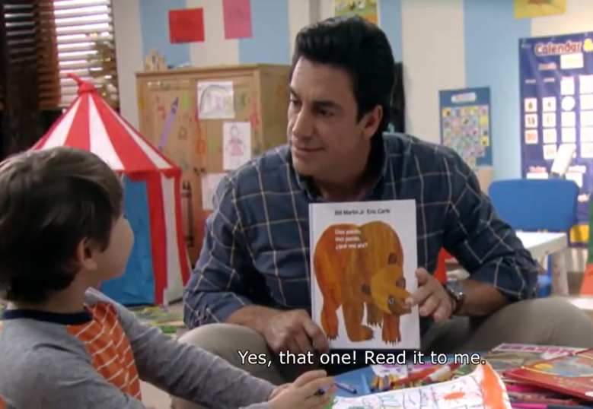
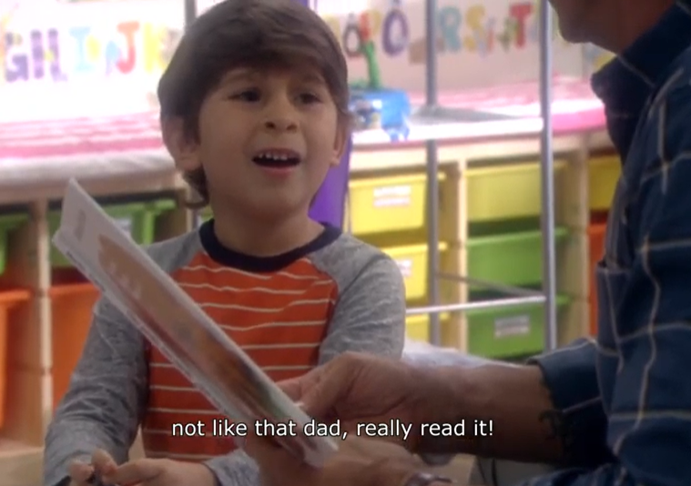
Mario & Santiago
Notes:
Mario is the parent of two boys.

Slide 7
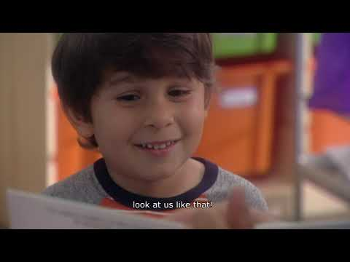
Notes:
3:25-3:35
10-minutes
https://youtu.be/_6u4byYIhNM
from 1:42-3:42 (2 minutes)
Q: What’s Happing?
q: What do you see that makes you think that?
q: What else can we find?
What if I told you that that Santiago is Mario’s youngest child. Santiago is a very agreeable child- however Mario is struggling a little bit with his oldest son Nicoloas.
All 3 are grieving - the mother has left the home making Mario a single dad.
Very busy, very serious and very stressed.

Slide 8
Community Learning Activity
Listening Exchange
Pair share....
One person is telling and the other listening.
Each person speaks for 2 minutes uninterrupted.
The Person speaking keeps the time.
Switch- do not comment on what the other person said.
Listen like you care about the speaker.
Notes:
3:35-3:45
10-minutes
Bring to mind your favorite storyteller from when you were a child. Someone you really loved listening to - who are they , what do they sound like, what did they tell you about, how do you feel remembering them in this way.
Q: WHo liked being the talker/ listener
Q: How did it feel to be listen to in that way?
Q: Uninterrupted?
HOw might a caregiver in your group need 2 minutes like this?
Facilitation Strategy
Equity voice and equal exchange
One to share their person - favorite narrator- who they thought of and why?
sure it?

Slide 9
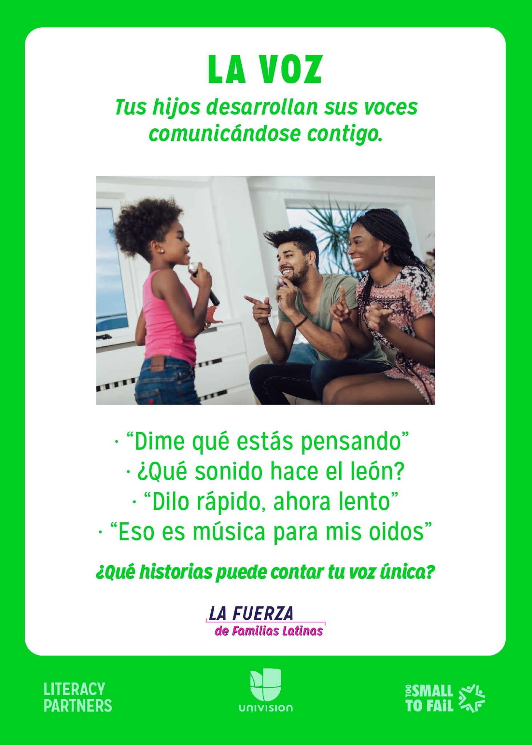
CONSEJO
Voice
Your child develops their voice while communicating with you.
Tell me, what you’re thinking.
What sound does a lion make?
Say it fast, now slow.
That is music to my ears.
What stories can your
unique voice tell?
Notes:
3:45-3:50
5-minutes
Let’s do a group discussion: In our workshops, we emphasize the use of their voice. After watching, a clip from the story, parents usually share their childhood experiences and their experiences as parents as well. One of the techniques we use to spark more conversation among all participants is by presenting a consejo card, like this one. This one says …..
Consejo
This world voice means so many different things;
Social-emotional
imaginative play and use of voice in reading and storytelling
opposites, velocity (science, engineering), adjectives
Social-emotional again- and music and senses
Q: WHat the biggest benefit - THEY DO IT WITH YOU- in communication with you.
Q: Give me another tip
Q: How might I draw from culture?

Slide 10
Community Learning Activity
Breakout (15-minutes)
With your peer coaches....
What are the approaches and frameworks that inform your work of shifting the caregiver relationship to power?
How might encouraging a caregiver to tell stories, sing or read to their child in their native language be an act of social justice?
Notes:
3:50-4:15 (4 ppl/group)
Send NOTES Powerpoint link in the chat:
ALLOW ACCESS
20-minutes
In the assignment you were asked to consider how stress and heart language impact the developing Voices of caregivers and their child.
You were asked to identify spheres of influence on Spanish-speaking caregivers.
With your peer coaches....
How might encouraging a caregiver to tell stories, sing or read to their child in their native language be an act of social justice?
We will take 10 minutes for this community learning activity
- when you go to break out choose a note taker to capture or add to your notes.
at 5 minutes we will prompt you to move towards discussion of goals.
we will pull you back into the the large group at 10 minutes.
MY CONNECTING POINTS
History of stifling bilingualism- not as a strength
Centers their stories and voice
EMPOWER vrs shift the caregivers relationship to power- they have power
Culturally Indigenous and afrolatino members of the community have an oppressive relationship with white centered culture in the countries they are migrating from- seen and not hear- that can be true about children
Permission to be good enough as they are today
sure it?

Slide 11
Community Learning Activity
...continued
What are Difficult Conversations?
Share your resource or tool.
Notes:
4:20-4:30
10-minutes
In the assignment you were asked to consider:find a resource or tool for facilitation that might benefit caregivers and
Review your notes
We will take 10 minutes for this community learning activity
- when you go to break out choose a note taker to capture or add to your notes.
at 5 minutes we will prompt you to move towards discussion of goals.
we will pull you back into the the large group at 10 minutes.
sure it?

Slide 12
Closing Circle
Tell us your name and share a highlight from the session.
“A highlight was _______________ .”
Then, tag the next person.
Notes:
4:30-4:45
10-minutes
Welcome to our Community Living Room.
Take a moment to fill in the blank
Opening and Closing circles are part of the routines and practices. At the end we will model the closing circle-
We open each session with an appreciation.
Q:What’s the value of starting each session with an appreciation?
Gratitude practices do more than just uplift.
As you are aware caregivers are navigating an interaction of issues and multiple barriers to feeling their powerful influence as their child’s most important person.
Get our minds in the game- we all have something to contribute.
This introduction is a story! A story we are telling about ourselves and the work of caring we all do.
Raise your hand if you worked hard today! Your work is hardwood- good work- important work.
You made time join this community of practice- your individual strengths.

Slide 13
Coaching
Sign up!
WhatsApp
Respond to the Moment of Connection Video Prompt.
ASSIGNMENT!
Create digital story using a household item
Visit:
Lafuerzadefamilias.org
See you tomorrow!
ANNOUNCEMENTS
Notes:
4:45-4:50

Slide 14
Contact:
Michelle López
michellel@literacypartners.org
www.lafuerzadefamilias.org
@fuerzafamlatina
@fuerzafamlatina
Notes:
Follow up:
MOC
Read Aloud: Sonadores https://www.lafuerzadefamilias.org/read-aloud/sonadores/

